Slide 1

Phase 1, Module 10: Advanced Loops & Iteration
Khyber AI Systems Engineer (KASE)
Welcome to Module 10. Today, we go beyond the basic 'for' loop. We will learn how to handle parallel data streams, how to track indexes without manual counters, and how to write powerful one-line data transformations.
Presented By: Zaryab Ahmad

Slide 2
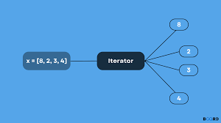
Iterables vs. Iterators
What’s Under the Hood?
Iterable: Any object you can loop over (List, String, Dictionary).
Iterator: The actual object that tracks the "current position" and fetches the next item.
The next() Function: How Python moves through a sequence.

Slide 3
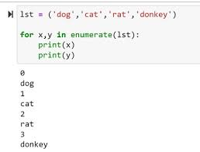
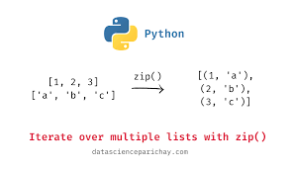

Parallel & Indexed Iteration
$enumerate()$and zip()
$enumerate():$Automatically tracks the index count while looping. No more i = 0 and i += 1.
zip(): Sews two or more lists together to process them in parallel.

Slide 4
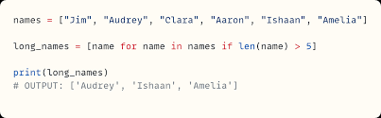

List Comprehensions (Clean Code)
The Power of the One-Liner
A compact way to create new lists from old ones.
Syntax: $[expression for item in iterable if condition]$
Performance: They are executed at near-C speeds, making them faster than standard loops.

